Slide 1
Analyzing Life-Style Habits of Individuals with Diabetes
&
The Importance of Validating Research
By: Nico Pollack
April 25th, 2019

Slide 2
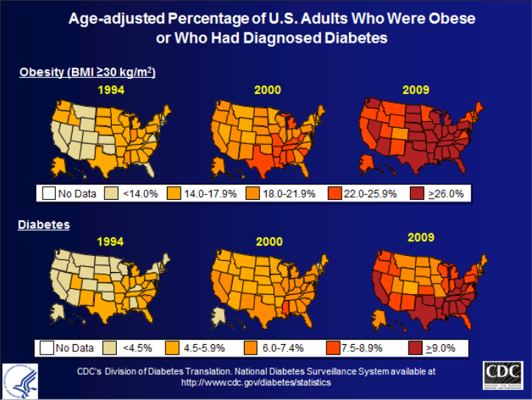
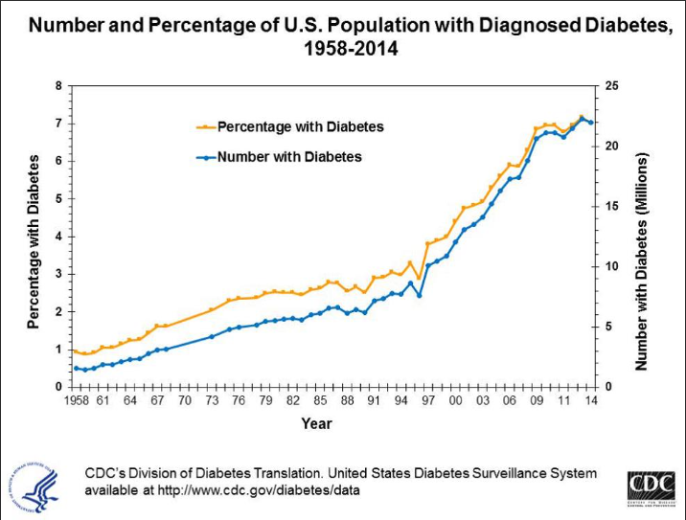
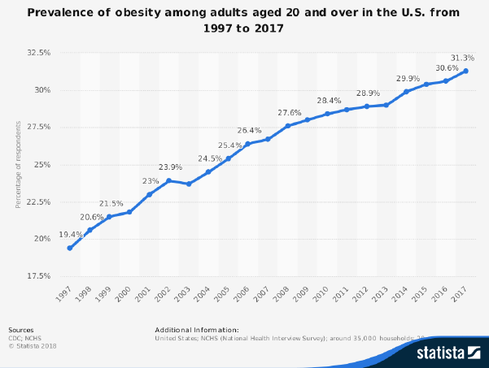
Diabetes is a nationwide epidemic

Slide 3
Living with diabetes – Exercise helps, smoking cigarettes does not
Benefits of Exercise
Harms of Smoking Cigarettes
Burns fat
Improves insulin use
Reduces stress
Protects against cardiovascular disease
Increases energy levels
Promotes healthier decision-making
Nicotine raises hemoglobin A1C by up to 34%
Increased kidney damage
Increased cardiovascular risk
Prone to infections
Higher risk of retinopathy – can cause blindness
Peripheral neuropathy - numbness
“ Smokers are 30-40% more likely to develop type 2 diabetes compared to non-smokers” – CDC

Slide 4
National health and nutrition examination survey (2013 – 2014) by: Center for Disease control and prevention
Contents:
Demographics.csv (10.2k x 47)
Diet.csv (9813 x 168)
Examination.csv (9813 x 224)
Labs.csv (9813 x 424)
Medications.csv (20.2k x 13)
Questionaire.csv (10.2k x 953)
Designed to assess the the health and nutritional status of adults and children in the United States
Unique in that it combines physical examination with interviews
Program began in early 1960s
Collects data from ~5,000 people each year from 15 counties across the country
Thousands of studies performed leveraging this data

Slide 5

Part II
The Importance of validating research

Slide 6
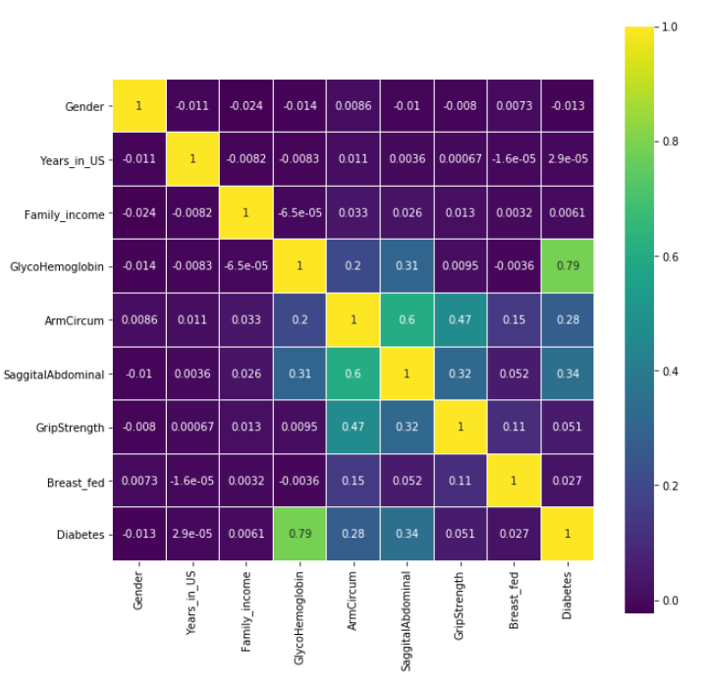
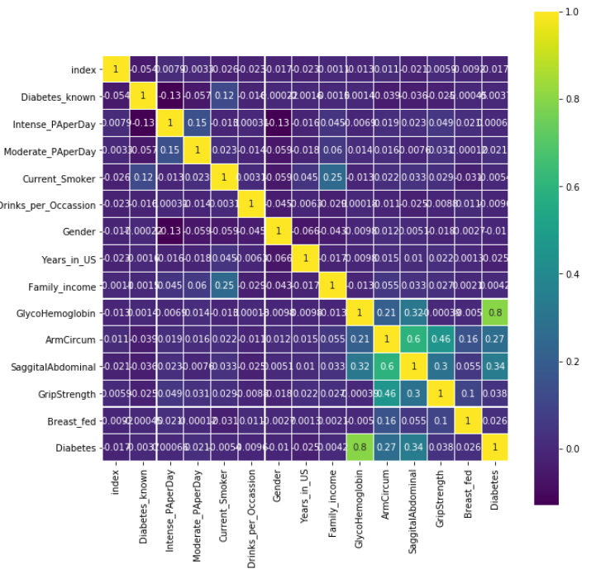
Kaggle – A diabetes predictor by: “Jinner”

Slide 7
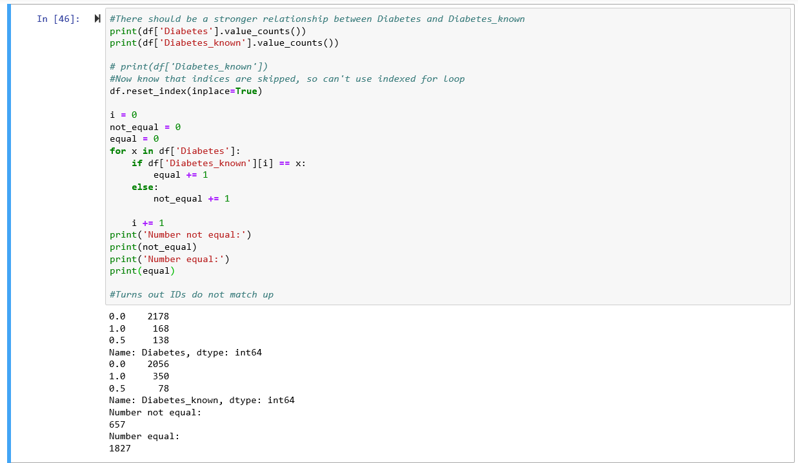
Why is diabetes from the questionnaire not Correlating with glycohemoglobin concentrations?

Slide 8
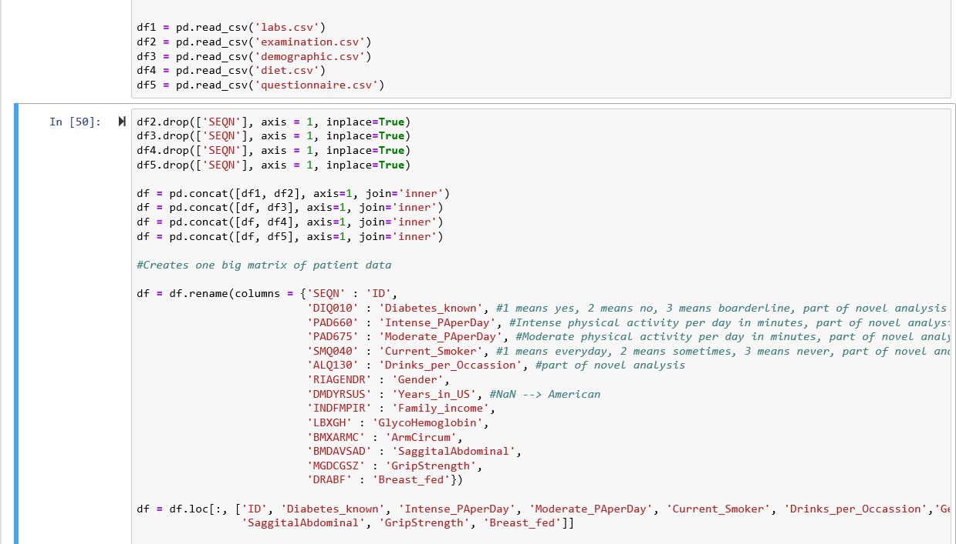
How was the data frame created?

Slide 9
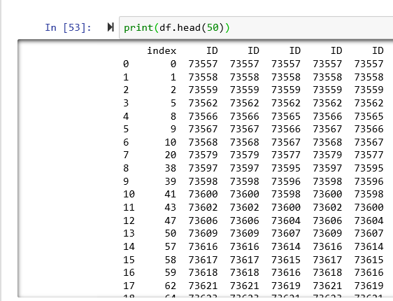
“Jinner” messed up

Slide 10
Replicating results is crucial, but it rarely happens
Problems
Potential Solutions
Scientists have few incentives to try replication
Journals’ tendency is to publish contradictory findings or conclusions
Studies are becoming more challenging to replicate
For many researchers, the goal is publishing quantity over quality
Tenure incentives for quality over quantity
Data due diligence to hold researchers accountable for leveraging bias data
Journals demanding more info to facilitate experiment replication
Encourage peer review

Slide 11

Next steps
Merge based on ID number; merge alternative data set as well?
Am I representing my data properly?
More Visualizations + Machine Learning Model…

Slide 12

Questions / Comments?

